Slide 1

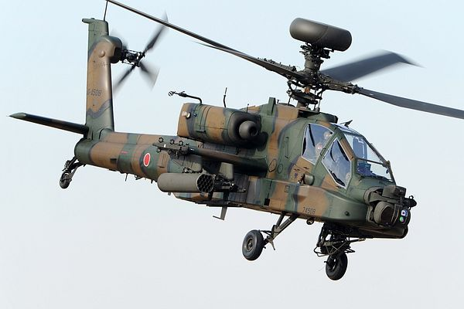
Heat Exchanger
for Demonstrator
ME476C
9-19-23
Uriah Whitaker:Team Lead
Dennis Decker:Manufacturing Engineer
Christopher Mason: Test Engineer
Lorenz Vios: CAD Engineer

Slide 2
Project Description
Project Description
Our project's primary objective is the design and creation of a liquid-to-liquid heat exchanger, with a strong emphasis on optimizing heat transfer efficiency. This advanced heat exchanger will be seamlessly integrated into a demonstrator, which serves as a practical representation of a helicopter cockpit, showcasing its ability to operate with a distinct refrigerant.
Sponsor
The project is sponsored by Boeing, a leading aerospace company. The significance of this project lies in its potential to revolutionize heat exchange technology within aviation, aligning with Boeing's commitment to innovation and efficiency in aircraft systems.
Importance
Environmental benefit:
Boeing is committed to transitioning from R-134a to R-1234yf, a more environmentally conscious refrigerant choice.
The noteworthy environmental benefit lies in R-1234yf, which has an environmental impact over 1,000 times lower in terms of climate change compared to R-134a. This transition represents a meaningful step toward sustainability.
- Safety:
It's important to note that R-1234yf, while environmentally friendly, possesses flammability risks.
The heat exchanger's vital role is to safeguard the cockpit from potential fires, ensuring the highest level of safety for both aircraft systems and personnel.
- Innovation:
This project serves as a testament to Boeing's unwavering dedication to innovation, a core principle driving their constant pursuit of advancements that enhance aircraft performance and sustainability.
The development of a more efficient and secure heat exchanger aligns perfectly with Boeing's commitment to pioneering aviation technology.
Uriah 9/19 BoeingHX F23toSp2405, 1

Slide 3
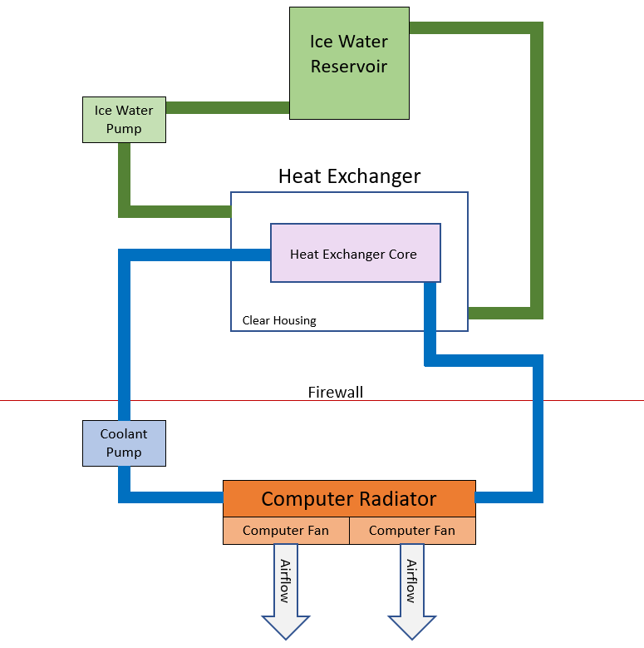
Project Description
Fig 1. Demonstrator Visual
Uriah 9/19 BoeingHX F23toSp2405, 2

Slide 4
Background & Benchmarking
Boeing Environmental Control System for Apache Helicopter [1]
- Can operate effectively in temperatures below 105º Fahrenheit
- Uses R-134a which has GWP 1430
- Not designed for HFO-1234yf which has a GWP<1 and is also mildly combustive
Our design implements a heat exchanger which keeps the environmentally friendly HFO-1234yf from combusting
General Motors Automotive Air conditioner [2]
- Uses HFO-1234yf
- Tested and never combusted under normal circumstances
- Has a built in firewall in case of engine failure not in case of refrigerant combustion
The cars that GM designed these for are not at risk for combustion because the refrigerant is never exposed to very high temperatures
Boeing 777 Environmental Control System [3]
- Uses R-134a
- No firewall in place in case of combustion of refrigerant
Our design implements a heat exchanger which keeps the environmentally friendly HFO-1234yf from combusting as well as a piece of sheet metal which represents a firewall to protect the pilots which the 777 plane does not have
‌
Chris 9/19 BoeingHX F23toSp2405, 3

Slide 5
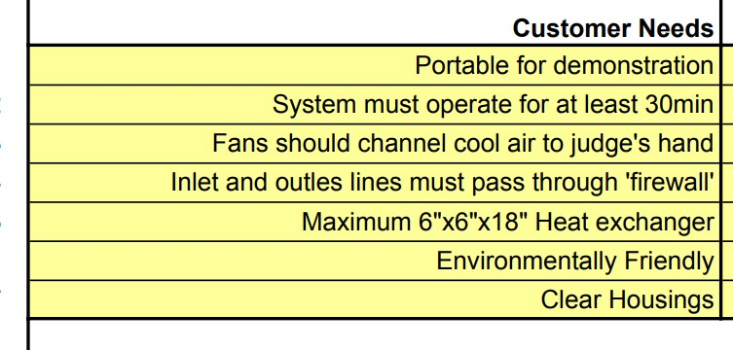
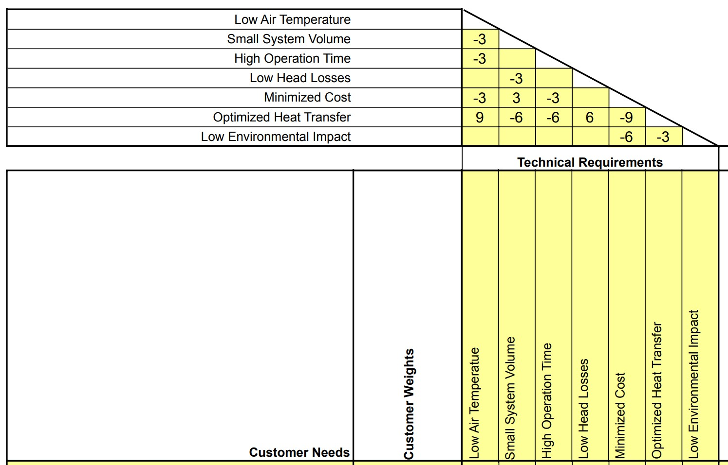
Customer and Engineering Requirements
Fig 2. Customer Needs
Technical Requirement comparison show that for product success balancing different project aspects is crucial
Fig 3. Technical Requirements
Dennis 9/19 BoeingHX F23toSp2405, 4

Slide 6
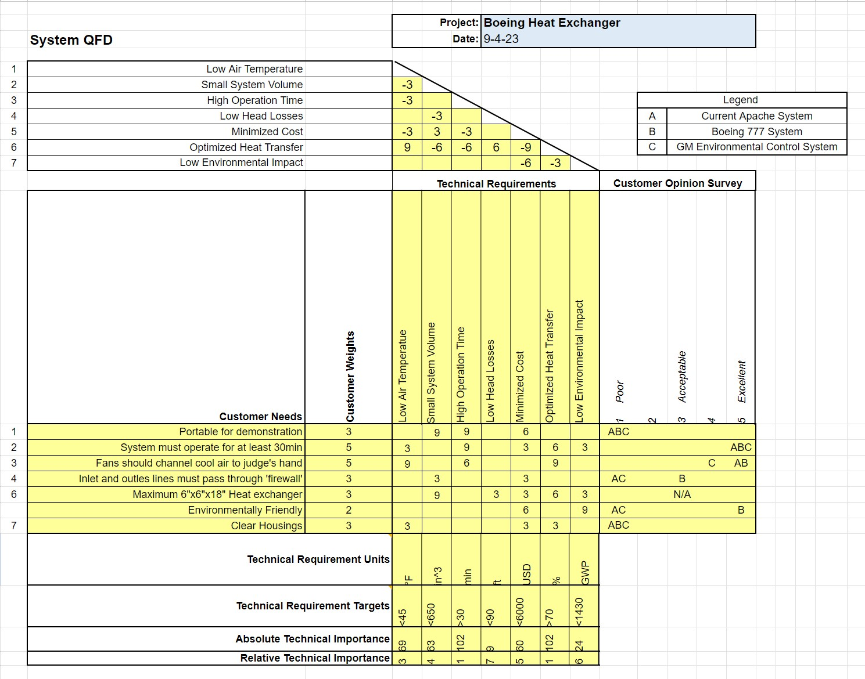
Dennis 9/19 BoeingHX F23toSp2405, 5

Slide 7
Coolant selection Lit Review
Textbooks
TM 1-1520-238-10 Operator’s Manual Helicopter, Attack, AH-64A Apache Chapter 2 page 64 [4]
The Operator's Manual for the AH-64A Apache provides information on performance criteria for the helicopter, which may include heat transfer and thermal performance requirements relevant to this project. Refer to Chapter 2, page 64, to access this information.
Fundamentals of Engineering Thermodynamics, 8th ed Chapter 2 [5]
Chapter 2 of the textbook "Fundamentals of Engineering Thermodynamics" covers fundamental concepts related to operating conditions for heat transfer systems. This information can help the team understand how to consider and analyze the specific conditions under which the heat exchanger will operate.
Fundamentals of Engineering Thermodynamics, 8th ed Chapter 8 [5]
Delves into fluid properties, including Fourier's Law, which is fundamental to heat transfer analysis. Understanding fluid properties is crucial for optimizing our heat exchanger's performance.
Provides information on heat transfer analysis. This chapter covers the principles and methods of analyzing heat transfer, which is central to your project's goals.
Uriah 9/19 BoeingHX F23toSp2405, 6

Slide 8
Coolant selection Lit Review Cont.
Papers
  Refrigeration, Air conditioning and Heating pumps [6]
  This paper contains information on how heat exchangers can impact energy efficiency and the environment. Understanding these aspects is important for designing an environmentally friendly and efficient heat exchanger.
  Thermodynamic optimization of finned crossflow heat exchangers for aircraft environmental control systems [7]
  This paper presents a new approach to optimizing the geometric features of flow components within larger systems by thermodynamically optimizing the entire system, rather than isolating individual components, using a counterflow heat exchanger in aircraft ECS as an example, and demonstrates its applicability to systems with limited onboard fuel.
Websites
  Environmental Control systems on Commercial Passenger Aircraft [8]
  This website cave us a standard to use for the Environmental Control systems (ECS) for passenger aircraft. This will help us pull accurate numbers for analysis.
  Mastering ANSYS with finite Element Analysis and CFD [9]
  This website will help with self-learning of the ANSYS software to analyze and model the Thermodynamic efficiency of the system.
Uriah 9/19 BoeingHX F23toSp2405, 7

Slide 9
Ice Water Reservoir Lit Review
Textbooks
Theodore L. Bergman’s ‘Fundamentals Of Heat and Mass Transfer: Ch 6 Intro to Convection [10]
- The reservoir will contain both ice cold water and heated water so there will be convection heat transfer between the two and we must calculate how the cold water will be affected if it is to remain ice cold
- There will also be convection heat transfer between the surface of the container and the flowing liquid which will involve some heat gain form the container
Fox and Mcdonald’s Introduction to Fluid Mechanics: Ch 4 Basic Equations In Integral Form For a Control Volume [11]
- In order to successfully calculate the heat transfer within the system we need to be able to calculate the mass flow rate as well as how the laws of thermodynamics will affect the system
Thermal and Acoustic Insulation [12]
- In order to make the ice water reservoir more efficient we must add thermal insulation so we can remove the heat gain from the container
Website
Final Temperature of mixtures (Richmann’s Law) [13]
- Since there will be two different water temperature mixing together, Richmann’s law offers an easy way to calculate the final temperature at any point as long as we know the mass and temperature of both temps of water at that point in time
Articles
Simon Ostrach’s Natural Convection in Enclosures [14]
- This article gives the team a better understanding of how convection currents will react within the reservoir as well as lists different experiments the author conducted that the team can relate the design to.
P.B.L Chaurasia’s Comparative study of insulating materials in solar water storage systems [15]
- This article although compares insulation for warmer temperatures should still have the same effect to keep the heat out for our ice water reservoir and in using these comparisons the team will be able to identify a insulator that will help remove the heat transfer between the container and the water
Thermo-economic analysis of a cold storage system in full and partial modes with two different scenarios [16]
- This article talks about ice water storage for refrigeration systems used in factories
Chris 9/19 BoeingHX F23toSp2405, 8
Notes:
Primary: independent rally racing teams, main design team, main contractor of the machine/manufacturing shop, investment teams
Supporting: manufacturing team, rally team crew
Tertiary: rally association
Extended: material suppliers of 1 metal/electronics, audience

Slide 10
Fluid Flow Lit Review
Textbooks
Fundamentals of Fluid Mechanics Ch 8 [11]
- Chapter of fluid dynamics textbook concerned with head losses in pipes for many cases
DOE Fundamentals Handbook: Heat Transfer, Thermodynamics, and Fluid Flow [17]
- The chapter on heat exchangers discusses the advantages of counter flow over parallel flow such as lower thermal stresses and uniform heat transfer across the heat exchanger.
Papers
Heat transfer and flow characteristics of a conical coil heat exchanger [18]
- This paper discusses how a curved double tube heat exchanger performs.
- The conical shape of the heat exchanger led to an increased heat transfer coefficient compared to a helical shape
Heat transfer enhancement for shell and coil heat exchanger [19]
- This paper discusses how to improve heat transfer using a shell heat exchanger with a coiled inner tube
Computational Fluid Dynamics Analysis for staggered and in-line shell and tube heat exchangers [20]
- This paper used CFD to examine the thermal efficiency of shell and tube heat exchangers in both a staggered and an in-line configuration
Websites
Shell and Tube Heat Exchanger Pressure Drop [21]
- This article discusses pressure drop in shell and tube heat exchangers
- The article describes a good method to calculate pressure drops on both sides of the heat exchanger, especially when accounting for baffles on the shell side
AFT Fathom [22]
- Modeling software for steady state fluid flow in pipe networks
Lorenz 9/19 BoeingHX F23toSp2405, 9

Slide 11
Heat Exchanger Lit Review
Textbooks
T. Kuppan’s ‘Heat exchanger Design Handbook’ [23]
- Encompasses most heat exchanger designs with good detail into selection process/Mathematical aspect
- Will be primary resource for Heat exchange design process as it has a chapter for all relevant design/manufacturing aspects
- chapters include but not limited to thermohydraulics, shell and tube heat exchangers, plate heat exchangers, mechanical design, material selection and fabrication
      Fundamentals of Heat and Mass Transfer Chapter 11 [10]
- Chapter of heat transfer book that explains in depth the math involved in analyzing heat exchangers, Engineering Textbook
Papers
James Coopers ‘Heat Exchangers: Characteristics, Types and Emerging Applications’ [24]
- Breaks down each heat exchanger type and where their strengths lie with numerical values that show compared to traditional shell and tube Heat exchangers
- The surface area required for a plate heat exchanger is 30-50% less than shell and tube heat exchanger
Design and Operation of Heat Exchangers and their Networks-Chapter 3:Steady State characteristics of Heat exchangers [25]
- Derives properties of heat exchangers based on flow and heat transfer characteristics at S.S. Condition
      Three-dimensional fin-tube expansion process to achieve high heat transfer efficiency in heat exchangers [26]
- Discusses how incorporating grooves on a fin-tube type heat exchanger to greatly improve heat transfer
- New 3D ball design dramatically decreases need to reduce fin size due to expansion
Websites
        Engineering Toolbox [27]
- Provides a large number of factors that will be needed to mathematically model a heat exchanger
GrabCad SolidWorks: How to perform a transient thermal analysis in SolidWorks [28]
- Provides a step-by-step walkthrough of how to accurately model the heat transfer in SolidWorks
Dennis 9/19 BoeingHX F23toSp2405, 10
Notes:
Top 3 ranked technical requirements were decrease lap time, increase average contact patch, and lowweight. These requirements reflect the client and stakeholder’s needs to win races.

Slide 12
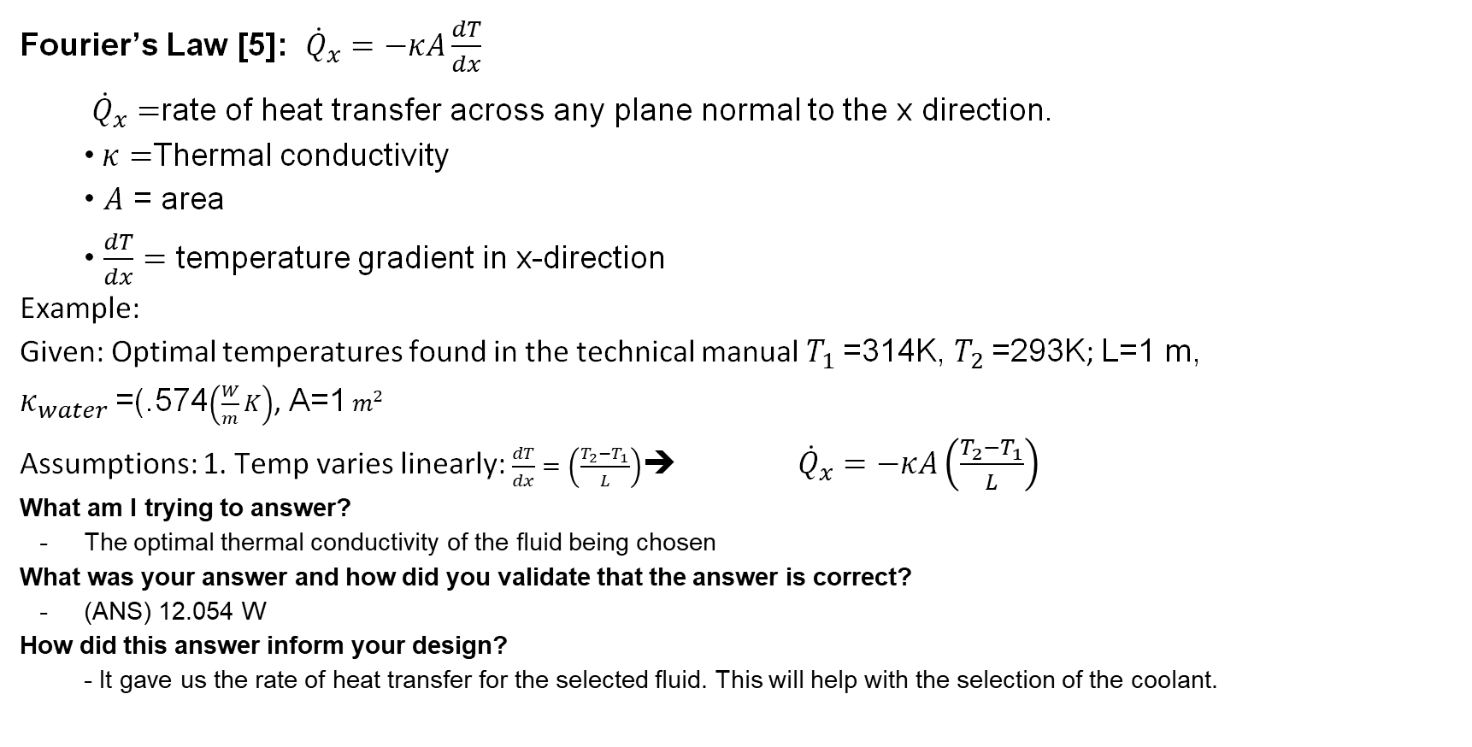
Mathematical Modeling Coolant selection
Fourier’s Law [5]: ${\dot{Q}}_{x}=−κA\frac{dT}{dx}$
${\dot{Q}}_{x}=$rate of heat transfer across any plane normal to the x direction.
•$κ=$Thermal conductivity
• $A$ = area
• $\frac{dT}{dx}=$ temperature gradient in x-direction
Example:
Given: Optimal temperatures found in the technical manual $T_{1}$=314K, $T_{2}$=293K; L=1 m, $κ_{water}$=(.574$\left(\frac{W}{m}K\right)$, A=1${ m}^{2}$
Assumptions: 1. Temp varies linearly: $\frac{dT}{dx}=\left(\frac{T_{2}−T_{1}}{L}\right)$➔ ${\dot{Q}}_{x}=−κA\left(\frac{T_{2}−T_{1}}{L}\right)$
What am I trying to answer?
The optimal thermal conductivity of the fluid being chosen
What was your answer and how did you validate that the answer is correct?
(ANS) 12.054 W
How did this answer inform your design?
- It gave us the rate of heat transfer for the selected fluid. This will help with the selection of the coolant.
Uriah 9/19 BoeingHX F23toSp2405, 11
Notes:
Top 3 ranked technical requirements were decrease lap time, increase average contact patch, and lowweight. These requirements reflect the client and stakeholder’s needs to win races.

Slide 13
Mathematical Modeling Ice Water Reservoir
Main Dependent equations
Initial Calculations assuming heat capacities are all the same [13]
The following Richmann’s Law equation relates the masses and temperatures of the water in the mixture to the final temperature of the mixture
T_{f}=(m_{c}x T_{c}+ m_{h}x T_{h})/(m_{c}+ m_{h})
m = Mass of cold and hot water
T = Temperature
In order to see how this equation works let's estimate the ice water to be 273 kelvin (0º Celsius) and 4.72 kg and the hot water to be 297 kelvin (24º Celsius) and 1.18 kg (masses are guessed upon 20 and 5 cups of water respectively)
(4.72 x 273 + 1.18 x 297)/(4.72 + 1.18) = 278.2 kelvin (5.2º Celsius)
What am i trying to answer?
-How much cold water will we need in order for the water to remain cold for 30 minutes
How did this answer inform your design?
-Going forward this equation will be the benchmark for our MATLAB modeling in order to figure out the amount of ice water the reservoir will need in order to stay cool for 30 minutes
Chris 9/19 BoeingHX F23toSp2405, 12

Slide 14
Mathematical Modeling Pressure Drop
Main Dependent equations [11]
(p₁/⍴+α₁*V₁²/2+g*z₁) – (p₂/⍴+α₂*V₂²/2+g*z₂) = h_{l} + h_{lm} h_{l} = ƒ*L/D*V^2/2 h_{lm} = K*V^2/2
p = pressure ⍴ = density α = kinetic energy coefficient
V = avg. velocity g = grav. accel. z = elevation
h_{l} = major head loss ƒ = friction factor (from Colebrook Eqn.) L = pipe length
D = pipe diameter h_{lm} = expansion head loss K = Minor loss coefficient
Initial Calculations:
Assuming no change in elevation, turbulent flow (α = 1),V₂ = 0, and K = 1:
Δp = ⍴(ƒ*L/D*V₁²/2)
With Q = 4gpm (V = .498m/s), 20ft of ½ in. plastic tubing, and ice water at T = 0℃, and ƒ = .0646 (iteratively solved using MATLAB):
Δp = 1000 kg/m³*(.0646*(6.096m/.0127m)*(.498m/s)²/2) = 3849.6 Pa or .558 psi
The pump is rated to provide 45 psi at the selected flow rate so the pump is suitable for our design in terms of pressure
Moving forward, these calculations will be re-evaluated to account for all losses in the system such as in the heat exchanger or in elbows.
Lorenz 9/19 BoeingHX F23toSp2405, 13

Slide 15
Mathematical Modeling Heat Exchanger
Main Dependent equation [10]
Initial Calculations
The Following equation relates the heat transfer to the specific heat capacity of the ‘cold’ fluid (Ice Water) and the inlet and outlet temperatures
q=ṁ_{c}*C_{c}(T_{co}-T_{ci})=25.08 KW
q=ideal heat transfer
ṁ_{c} =.25 kg/s -mass flow rate of cold water C_{c}=4.18 kJ/kg°C -Specific Heat Capacity of water
T_{co}=24 °C -Temperature of water outlet T_{ci}=0 °C -Temperature of water outlet
What am i trying to answer?
- How much heat transfer needs to occur in our design
What was your answer?
- for our system to operate at the desired temperatures the transfer of 25.08 KW of heat energy must occur
How did this answer inform your design?
-This answer will help in determining design factors such as material choice, area of heat transfer surface, thickness as well as many other factors
Next Step in Mathematical Modeling
-Use MATLAB to write a program that can balance equations related to thermohydraulics, efficiency aspects, pipe flows and many other components to help select the optimal pipe/plate sizes, thicknesses, lengths, materials and number of tubes/plates for our desired heat transfer
Dennis 9/19 BoeingHX F23toSp2405, 11

Slide 16
Budget
Project Funding Estimated Expenditures
  $5,000 provided by Boeing - $ 137.98 for 2 QTY Pumps
  $1,000 provided by VA grant - $ 13.76 for Plastic Tubing - $ 22.99 for Radiator
- $ 45.12 for 2 QTY fans
- $ 15.95 for fan power supply
- $ 14.91 for pump power supply
- $ 83.40 for 30 ft of copper tubing (approx.)
- $ 200.00 for reservoir (approx.)
Total Income: $ 6,000.00
Known Expenses: $ 534.11
_______________________________
Available Capital: $ 5,465.89
Costs will increase as design is finalized (Reservoir size, custom components, etc.)
Lorenz 9/19 BoeingHX F23toSp2405, 15

Slide 17
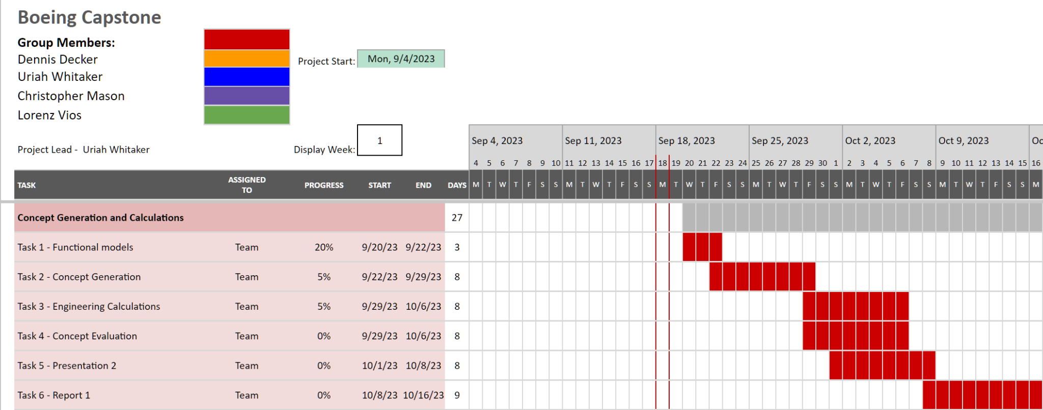
Schedule
Table 1. Partial Gantt Chart of Next Project Phase
Lorenz 9/19 BoeingHX F23toSp2405, 16

Slide 18
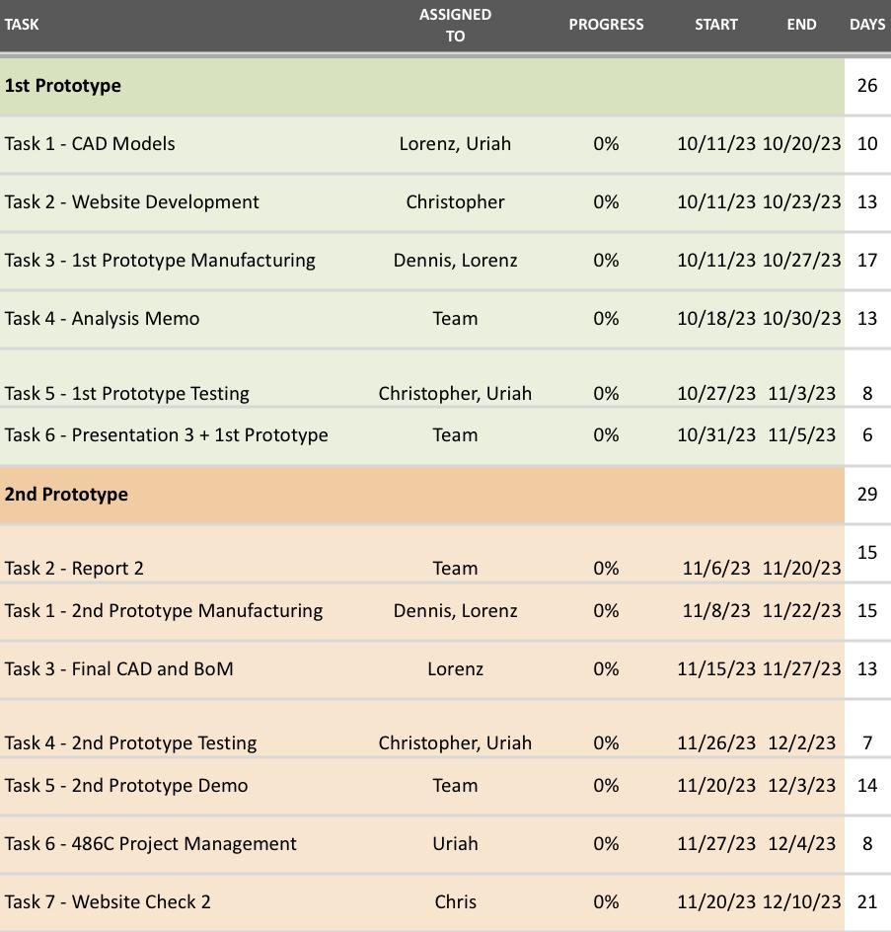
Table 2. Gantt Chart (cont.)
Lorenz 9/19 BoeingHX F23toSp2405, 17

Slide 19
Thank You

Slide 20
References
[1] Boeing AH-64A APache Helicopter Operating Manual. Boeing, 06/28/1984. (can provide if needed)
[2] Genera Motors, “The Transition from HFC-134a to a Low-GWP Refrigerant in Mobile Air Conditioners,” epa.gov, Oct. 29, 2013. https://www.epa.gov/sites/default/files/2014-09/documents/sciance.pdf#:~:text=In%20response%20to%20the%20Daimler%20actions%2C%20General%20Motors,crash%20tests%20on%20GM%20vehicle%20platforms%20using%20HFO-1234yf
[3] Boeing-777-FCOM. Boeing, 01/11/02. http://www.ameacademy.com/pdf/boeing/Boeing-777-FCOM.pdf
[4] TM Helicopter, Attack, AH-64A Apache Operator's Manual, Department of the Army, Headquarters, USA, 1994
[5] M. J. Moran, H. N. Shapiro, M. B. Bailey, and D. D. Boettner, Fundamentals of Engineering Thermodynamics, 8th ed. Hoboken, NJ: Wiley, 2010.
[6] F. Polonara and F. Polonara, Refrigeration, Air Conditioning and Heat Pumps Energy and Environmental Issues. Basel, Switzerland: MDPI - Multidisciplinary Digital Publishing Institute, 2021.
[7] J. V. C. Vargas and A. Bejan, “Thermodynamic optimization of finned crossflow heat exchangers for aircraft environmental control systems,” International Journal of Heat and Fluid Flow, vol. 22, no. 6, pp. 657–665, Dec. 2001, doi: https://doi.org/10.1016/s0142-727x(01)00129-1.J. V. C. Vargas and A. Bejan, “Thermodynamic optimization of finned crossflow heat exchangers for aircraft environmental control systems,” International Journal of Heat and Fluid Flow, vol. 22, no. 6, pp. 657–665, Dec. 2001, doi: https://doi.org/10.1016/s0142-727x(01)00129-1.
[8] E. Hunt, D. Reid, D. Space, and F. Tilton, “Commercial Airliner Environmental Control System Engineering Aspects of Cabin Air Quality.” Available: https://www.smartcockpit.com/docs/Engineering_Aspects_of_Cabin_Air_Quality.pdf ‌
[9] Online Courses - Learn Anything, On Your Schedule | Udemy, “Online Courses - Learn Anything, On Your Schedule | Udemy,” Udemy, 2015. http://www.udemy.com
[10] T. L. BERGMAN, “Chapter 11,” in Fundamentals of heat and mass transfer, S.l.: WILEY, 2020
[11] R. W. Fox, Fox And Mcdonald’s Introduction To Fluid Mechanics. S.L.: John Wiley, 2020.
[12] R M E Diamant, Thermal and acoustic insulation. London: Butterworths, 1986.
[13] tec-science, “Final temperature of mixtures (Richmann’s law),” tec-science, Jan. 20, 2021. https://www.tec-science.com/thermodynamics/temperature/richmanns-law-of-final-temperature-of-mixtures-mixing-fluids/
[14] S. Ostrach, “Natural Convection in Enclosures,” Journal of Heat Transfer, vol. 110, no. 4b, pp. 1175–1190, Nov. 1988, doi: https://doi.org/10.1115/1.3250619.
[15] P. B. L. Chaurasia, “Comparative study of insulating materials in solar water storage systems,” Energy Conversion and Management, vol. 33, no. 1, pp. 7–12, Jan. 1992, doi: https://doi.org/10.1016/0196-8904(92)90141-i.

Slide 21
References
[16] A. R. Shaibani, M. M. Keshtkar, and P. Talebizadeh Sardari, “Thermo-economic analysis of a cold storage system in full and partial modes with two different scenarios: A case study,” Journal of Energy Storage, vol. 24, p. 100783, Aug. 2019, doi: https://doi.org/10.1016/j.est.2019.100783.
[17] DOE Fundamentals Handbook: Thermodynamics, Heat Transfer, and Fluid Flow, vol. 2, United States. Dept. of Energy, Oak Ridge, TN, USA, 1992.
[18] A. Sheeba, R. Akhil, and M. J. Prakash, “Heat transfer and flow characteristics of a conical coil heat exchanger,” International Journal of Refrigeration, vol. 110, pp. 268–276, 2020. doi:10.1016/j.ijrefrig.2019.10.006
[19] R. Kumar, P. Chandra, and Prabhansu, “Innovative method for heat transfer enhancement through shell and coil side fluid flow in shell and helical coil heat exchanger,” Archives of Thermodynamics, vol. 41, no. 2, pp. 239–256, 2020. doi:10.24425/ather.2020.133631
[20] S. Sharma et al., “Computational fluid dynamics analysis of flow patterns, pressure drop, and heat transfer coefficient in staggered and inline shell-tube heat exchangers,” Mathematical Problems in Engineering, vol. 2021, pp. 1–10, Jun. 2021. doi:10.1155/2021/6645128
[21] “Shell & Tube Heat exchanger pressure drop,” EnggCyclopedia, https://enggcyclopedia.com/2019/05/shell-tube-heat-exchanger-pressure-drop/ (accessed Sep. 13, 2023).
[22] “Steady State Pipe Flow Modeling Software,” Applied Flow Technology, https://www.aft.com/products/fathom (accessed Sep. 19, 2023).
[23] M. Pennington, “Heat Exchanger Design Handbook,” Academia.edu, https://www.academia.edu/4715789/Heat_Exchanger_Design_Handbook (accessed Sep. 14, 2023).
[24] J. K. Cooper, Ed., Heat exchangers : characteristics, types and emerging applications. New York: Novinka, 2016.
[25] “Design and Operation of Heat Exchangers and their Networks, https://www-sciencedirect-com.libproxy.nau.edu/science/article/pii/B9780128178942000030 (accessed Sep. 14, 2023).
[26] “Three-dimensional fin-tube expansion process to achieve high heat transfer efficiency in heat exchangers,” Springer Link, https://link-springer-com.libproxy.nau.edu/article/10.1007/s12206-019-0836-6 (accessed Sep. 19, 2023).
[27] “The engineering toolbox,” Engineering ToolBox, https://www.engineeringtoolbox.com/index.html (accessed Sep. 17, 2023).
[28] D. L. 8 Jun, D. Lane, and 8 Jun, “Tutorial: How to perform a transient thermal analysis in SolidWorks,” Tutorial: How to perform a transient thermal analysis in SolidWorks | GrabCAD Tutorials, https://grabcad.com/tutorials/tutorial-how-to-perform-a-transient-thermal-analysis-in-solidworks (accessed Sep. 18, 2023).
‌

